Slide 1


OCR Level 02 – Cambridge Technical
Unit 05 – Creating Business Solutions
2016 Specification - L/615/1355
LO1 - Understand the Role of the Digital Business Practitioner

Slide 2
Assessment Criteria
The Learner will | Pass The assessment criteria are the pass requirements for this unit. The learner can: | Merit To achieve a merit the evidence must show that, in addition to the pass criteria, the learner is able to: | Distinction To achieve a distinction the evidence must show that, in addition to the pass and merit criteria, the learner is able to:
1. Understand the role of the digital Business Practitioner | P1: Describe how the digital business practitioner supports business.
2. Be able to design solutions to meet business needs | P2: Design a solution to meet the identified business need. |  | D1: Justify how the design proposal supports the business needs.
3. Be able to present business solutions to stakeholders | P3: Create a prototype of the proposed business solution. | M1: Modify the design in response to stakeholder feedback.
 | P4: Present the prototype to identified stakeholders.
4. Be able to use IT applications to meet business needs. | P5: Create the proposed business solution. | M2: Test the solution to confirm functionality. | D2: Assess the appropriateness of the solution to the business need.
 | P6: Gather feedback from stakeholders of the proposed solution.

Slide 3
LO1 – Learning Outcome
e
Learning Outcome 1: Understand the role of the digital business practitioner
Your task is to: produce an information guide to include with the application form for the post of a digital business practitioner in Progress Solutions for Business. This should tell an applicant for the post what a digital business practitioner does.
Pass | Merit | Distinction
P1: Describe how the digital business practitioner supports business
Evidence
A detailed information guide. This must include: a description of how the digital business practitioner supports business; what the role means; what the characteristics and responsibilities of a digital business practitioner are.

Slide 4
Assessment Criterion P1
P1 - The learner is required to describe how the digital business practitioner supports business. The learner will need to undertake some investigation of
what the role means and consider the characteristics and responsibilities. The evidence could be in the form of a detailed careers guide or a presentation
with detailed speaker notes.

Slide 5
LO1 - Assessment Criterion
1.1. Characteristics of a digital practitioner, i.e.:
responsive to change (e.g. emerging technologies, methods of working)
keeps an open mind to possible developments
strives to be competent in a range of technology (generic, e.g. spreadsheets, presentation software, database and specific, e.g. social media for business purposes, web creation or website enhancement)
aware of rights and responsibilities when using IT (e.g. Data Protection Act 1998, Computer Misuse Act 2000, Police Act 2010, Equality Act 2010, Copyright, Designs and Patents Act 1998, Health and Safety at Work Act 1974, EU-USA Agreement on Data Protection)
facilitator for business use of IT
reflects on best practice.
1.2. Responsibilities, e.g.:
supporting non-IT specialists, i.e.:
  innovations relevant to the business, i.e.:
    new business opportunities (e.g. using web and mobile technology)
    new IT innovations (e.g. aiding the introduction of: faster broadband, new mobile applications, improvements to web design, new hardware and software)
  how to use current and new technologies as they become available, e.g. help businesses use these to improve productivity
being able to explain what IT is available without resorting to jargon
having relevant experience and understanding of a particular business or business area (e.g. business functional areas such as Human Resources, Production, Finance, Sales, Purchasing, etc.)
remaining up to date in business practice (e.g. remote working, remote control of facilities)
contributing to the improvement of business practice through the use of IT to aid business improvement (e.g. participate I project management, project design such as new networks, hardware and software installation and upgrade, development of new uses for the IT).

Slide 6
Unit 05 - Scenario
IT applications are commonly found in businesses. Digital practitioners play an important role in supporting businesses. You will design and create a business solution in conjunction with a stakeholder.
Progress Solutions for Business
Progress Solutions for Business is an existing organisation that offers administration services for businesses and organisations, as well as creating business solutions. The staff consists of:
a manager who has overall control of the organisation and also markets Progress Solutions for Business to external clients;
a supervisor who oversees the work of the administrative staff;
six administrative staff who provide the administration services.
It provides the following services:
word processing of reports and letters;
production of leaflets and brochures with graphical images;
creation of presentations which could include graphical images, video and audio clips and animations;
spreadsheet solutions;
database solutions;
website creations;
social media consultancy;
business IT applications.
A client, Westwood Recruitment Services (WRS), is an employment agency which specialises in providing staff for the hospitality industry. The agency has vetted the CVs supplied to them by applicants to match these with a potential job role e.g. chef. When an employer has a vacancy for a job such as a chef, WRS will let applicants know about the job role and find out if they wish to be interviewed for the position. WRS will set a closing date, and after the closing date it will arrange interviews for all the applicants interested in the post, sending them a letter inviting them for interview. The letter will inform the applicant about the location, date and time of the interview, as well as any other key details that may be relevant.

Slide 7
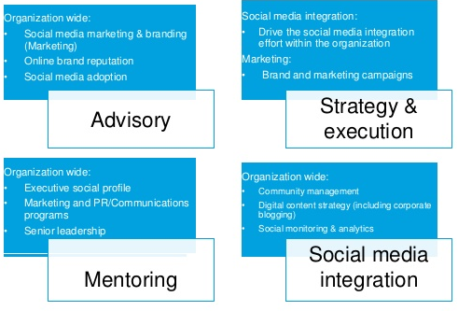
P1.1 – Digital Practitioner Characteristics
Digital practitioners play an important role in supporting businesses. They are the technicians and technical help needed to put change into action.
For this project you need to explain what a Digital Practitioner is, what they do, how they are used and perform the role of one for a specific project purpose.
  responsive to change (e.g. emerging technologies, methods of working)
  keeps an open mind to possible developments
  strives to be competent in a range of technology (generic, e.g. spreadsheets, presentation software, database and specific, e.g. social media for business purposes, web creation or website enhancement)
  aware of rights and responsibilities when using IT (e.g. Data Protection Act 1998, Computer Misuse Act 2000,
  Police Act 2010, Equality Act 2010,
  Copyright, Designs and Patents Act 1998,
  Health and Safety at Work Act 1974,
  EU-USA Agreement on Data Protection)
  facilitator for business use of IT
  reflects on best practice.

Slide 8
P1.1 – Digital Practitioner Characteristics
The roles of a Digital Practitioner can be broken down into 3 categories, Technical, Creative and Legal.
In terms of technical ability a Digital Practitioner will strive to be competent in a range of technology (generic, e.g. spreadsheets, presentation software, database and specific, e.g. social media for business purposes, web creation or website enhancement).
In business this means the person will understand the technical aspects of the business needs, how to create report, projects, how to do almost anything in a spreadsheet, how to format and use databases, how to improve social media content. They will be technicians with experience and ability.
In terms of the following tasks, describe a Digital Practitioners’ technical role:
  word processing of reports and letters;
  production of leaflets and brochures with graphical images;
  creation of presentations which could include graphical images, video and audio clips and animations;
  spreadsheet and database solutions;
  website creations;
  social media consultancy;
  business IT applications.
P1.1 – Task 01 – In context of Progress Solutions for Business, describe the technical characteristics of a Digital Practitioner.

Slide 9
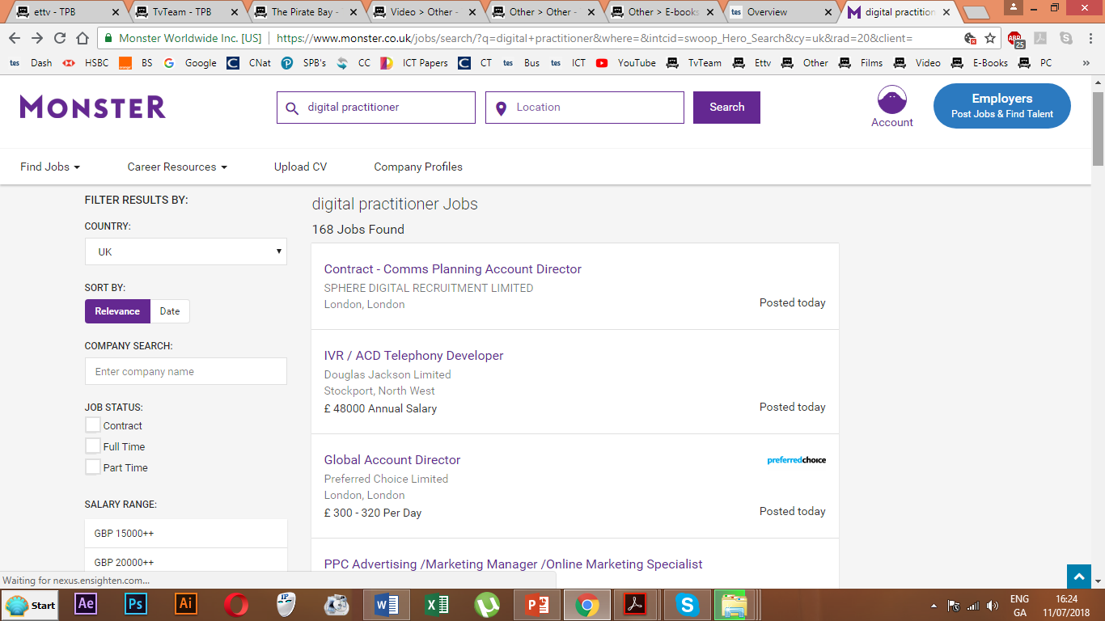
P1.2 – Digital Practitioner Characteristics
In terms of creativity a Digital Practitioner will be expected to be a:
  facilitator for business use of IT
  reflects on best practice
  responsive to change (e.g. emerging technologies, methods of working)
  keeps an open mind to possible developments
In business this means the person will be able to adapt, describe and solve digital problems that are proposed, come up with solutions to issues, and adapt to modern and emerging technologies in order to improve their future solutions.
In terms of the following tasks, describe a Digital
Practitioners’ technical role:
  Presenting solutions to problems
  Keeping up to date with developments.
  Improving the effectiveness of their practice.
  Improving theirs and other staff’s working practice.
  Presenting solutions to IT problems within the
  company.
P1.2 – Task 02 – In context of Progress Solutions for
Business, describe the creativity characteristics of a Digital Practitioner.

Slide 10
P1.3 – Digital Practitioner Characteristics
In terms of legal understanding a Digital Practitioner will need to aware of the legal IT restrictions that are in place in this country and others if the company is dealing with abroad. These legal restrictions can impact practice and someone has to be more aware of them than others.
For example, the following laws are in place to cover the ICT issues that arise:
  Data Protection Act 1998,
  Computer Misuse Act 2000,
  Police Act 2010,
  Equality Act 2010,
  Copyright, Designs and Patents Act 1998,
  Health and Safety at Work Act 1974,
  EU-USA Agreement on Data Protection
Each of these will have an impact to some degree on the working practices, data usage and storage, hiring practices and use of computers within working environments. A digital practitioner is there not only to keep the company legal, but to advise other companies of the same legal parameters and to draw up solutions to these legal problems.
P1.3 – Task 03 – In context of Progress Solutions for Business, describe the legal characteristics of a Digital Practitioner.
For this you will need to research a fraction of the ICT related issues of each of these laws and state why a Digital Practitioner needs to be aware of them.

Slide 11
P1.4 – Digital Practitioner Responsibilities
The following are the considered responsibilities of a Digital Practitioner.
  Supporting non-IT specialists, i.e.:
    Innovations relevant to the business, i.e.:
      New business opportunities (e.g. using web and mobile technology)
      New IT innovations (e.g. aiding the introduction of: faster broadband, new mobile applications, improvements to web design, new hardware and software)
    How to use current and new technologies as they become available, e.g. help businesses use these to improve productivity
  Being able to explain what IT is available without resorting to jargon
  Having relevant experience and understanding of a particular business or business area (e.g. business functional areas such as Human Resources, Production, Finance, Sales, Purchasing, etc.)
  Remaining up to date in business practice (e.g. remote working, remote control of facilities)
  Contributing to the improvement of business practice through the use of IT to aid business improvement (e.g. participate I project management, project design such as new networks, hardware and software installation and upgrade, development of new uses for the IT).

Slide 12
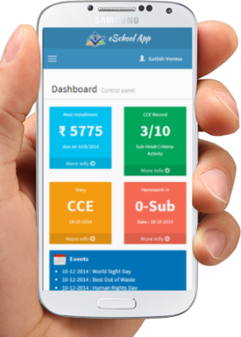
P1.4 – Digital Practitioner Responsibilities
It is usually a business consultancy that hires a Digital Practitioner but assume for a moment that your school hired a digital media technician who was given all these responsibilities. Describe for each role, how the person could set up and improve the standard of digital media and awareness of the students, the teachers and the school as a whole.
For example:
  Innovations relevant to the business, i.e.:
For a school this would mean the person would be researching new technologies relevant to teaching and learning, smart board technologies, the use of tablets within the school, digital books instead of paper books, the use of VLE’s and digitally submitting work, the introduction of cloud registrations of pupils, fingerprint payment systems, top-up cards, faster internet within the school, a better web presence.
Part of that role would be to test and integrate these into the
classrooms, then teach teachers how to use them effectively.
P1.4 – Task 04 – Describe in context of a scenario, the
responsibilities of a Digital practitioner, in terms of support,
training, experience and business improvement.

Slide 13
LO1 – Assessment Criteria
P1.1 – Task 01 – In context of Progress Solutions for Business, describe the technical characteristics of a Digital Practitioner.
P1.2 – Task 02 – In context of Progress Solutions for
Business, describe the creativity characteristics of a Digital Practitioner.
P1.3 – Task 03 – In context of Progress Solutions for Business, describe the legal characteristics of a Digital Practitioner.
P1.4 – Task 04 – Describe in context of a scenario, the responsibilities of a Digital practitioner, in terms of support, training, experience and business improvement.

